Slide 1
Software engineering module – V Implementation & Testing
Semester VI B.Tech. CSE Viswajyothi College of Engineering

Slide 2
Introduction
The implementation stage of software development is the process of converting a system specification into an executable system.
May involve
Developing programs in high- or low-level programming languages or
Tailoring and adapting generic, off-the-shelf systems to meet the specific requirements of an organization.

Slide 3
Implementation Techniques
Top-down Implementation
If module M1 calls module M2, then M1 is implemented and integrated before M2.
One possible top-down ordering is
a, b, c, d, e, f, g, h, i, j, k, l, m
Another possible top-down ordering is
a
[a] b, e, h
[a] c, d, f, i
[a, d] g, j, k, l, m
Stubs

Slide 4
Contnd..
Advantage 1: Fault isolation
Previously successful test case fails when Mnew is added to what has been tested so far.
Advantage 2: Stubs not wasted
Stub expanded into corresponding complete module at appropriate step
Advantage 3: Major design flaws show up early
Logic modules include decision-making flow of control
In the example, modules a, b, c, d, g, j
Operational modules perform actual operations of module
In the example, modules e, f, h, i, k, l, m
Logic modules are developed before operational modules

Slide 5
Contnd..
Problem 1
Reusable modules are not properly tested
Lower level (operational) modules are not tested frequently
The situation is intensified if the product is not well designed
Defensive programming (fault shielding)
Example:
if (x >= 0)
y = computeSquareRoot (x, errorFlag);
Never tested with x < 0
Reuse implications

Slide 6
Contnd..
Bottom-up Implementation
If module M1 calls module M2, then M2 is implemented and integrated before M1
One possible bottom-up ordering is
l, m, h, i, j, k, e, f, g, b, c, d, a
Another possible bottom-up ordering is
h, e, b
i, f, c, d
l, m, j, k, g [d]
a [b, c, d]
Drivers

Slide 7
Contnd..
Advantage 1
Operational modules thoroughly tested
Advantage 2
Operational modules are tested with drivers, not by fault shielding, defensively programmed calling modules.
Advantage 3
Fault isolation
Difficulty 1
Major design faults are detected late
Solution
Combine top-down and bottom-up strategies making use of their strengths and minimizing their weaknesses

Slide 8
Contnd..
Sandwich Implementation
Logic modules are implemented and integrated top-down
Operational modules are implemented and integrated bottom-up
Finally, the interfaces between the two groups are tested

Slide 9
Contnd..
Advantage 1
Major design faults are caught early
Advantage 2
Operational modules are thoroughly tested
They may be reused with confidence
Advantage 3
There is fault isolation at all times

Slide 10
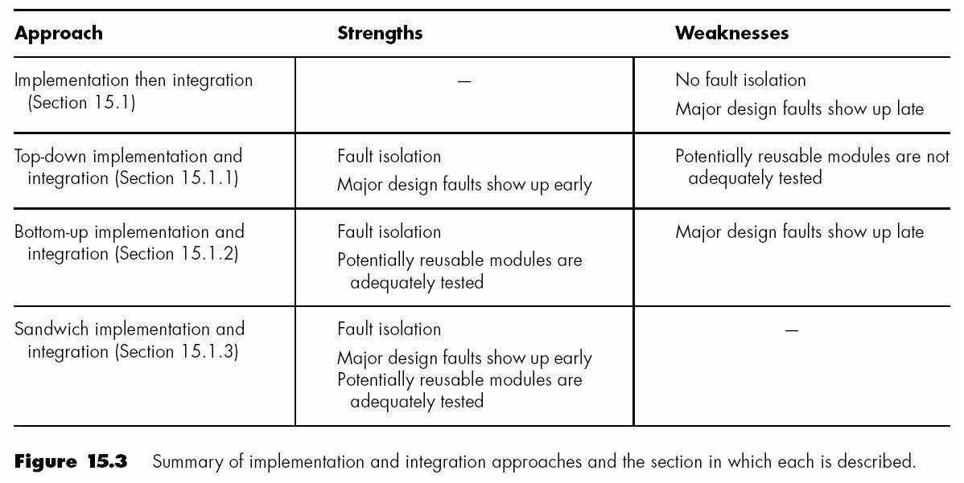
Summary

Slide 11
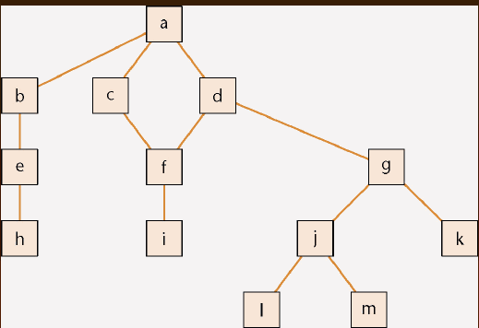
Implementation Techniques
Drivers and Stubs

Slide 12
Contnd..
To test module a, modules b, c, d must be stubs
Empty module, or
Prints message ("Procedure radarCalc called"), or
Returns precooked values from preplanned test cases
To test module h on its own requires a driver, which calls it
Each time checking value returned if tested;
Once, or Several times
Testing module d requires a driver and two stubs

Slide 13
Contnd..
Problem 1
Stubs and drivers must be written, then thrown away after module testing is complete
Problem 2
Lack of fault isolation
A fault could lie in any of 13 modules or 13 interfaces
In a large product with, say, 103 modules and 108 interfaces, there are 211 places where a fault might lie
Solution to both problems
Combine module and integration testing
“Implementation and integration phase”

Slide 14
Implementation Techniques
Imperative languages (procedural or object-oriented)
Functional languages
Logic languages.
Procedural Programming
A programming paradigm, derived from structured programming
Based upon the concept of the procedure call.
Procedures, also known as routines, subroutines, methods, or functions
Contain a series of computational steps to be carried out.
Any given procedure might be called at any point during a program's execution, by other procedures or itself.

Slide 15
Contnd..
Object-oriented Programming
A programming paradigm that uses "objects" to design applications and computer programs.
Data structures consisting of data fields and methods together with their interactions.
Programming techniques may include features such as data abstraction, encapsulation, modularity, polymorphism, and inheritance.
Viewed a collection of interacting objects,
In the conventional model, a program is seen as a list of tasks (subroutines) to perform.
Each object is capable of receiving messages, processing data, and sending messages to other objects.
Each object can be viewed as an independent 'machine' with a distinct role or responsibility.
The methods on these objects are closely associated with the object.
In the conventional model, the data and operations on the data don't have a tight, formal association.

Slide 16
Contnd..
Functional Programming
A programming paradigm that treats computation as the evaluation of mathematical functions and avoids state and mutable data.
The difference between a mathematical function and imperative programming
Imperative functions can have side effects,
Changing the value of already calculated computations.
Lack referential transparency, i.e.
The same language expression can result in different values at different times depending on the state of the executing program.
In functional code, the output value of a function depends only on the arguments that are input to the function,
Calling a function f twice with the same value for an argument x will produce the same result f(x) both times.
Eliminating side effects can make it much easier to understand and predict the behaviour of a program.

Slide 17
Contnd..
Logic programming
Uses mathematical logic for computer programming.
Logic is used as a purely declarative representation language, and a theorem-prover or model-generator is used as the problem-solver.
The problem-solving task is split between the programmer, who is responsible only for ensuring the truth of programs expressed in logical form, and the theorem-prover or model-generator, which is responsible for solving problems efficiently.

Slide 18
Contnd..
How to choose a programming language
Cost–benefit analysis
Compute costs and benefits of all relevant languages
Risk Analysis
First generation languages
Machine languages- Binary
Second generation languages
Assemblers- Symbolic notaions
Third generation languages
High-level languages (COBOL, FORTRAN, C++, Java)
Fourth generation languages (4GLs)
One 3GL statement is equivalent to 5–10 assembler statements
Each 4GL statement was intended to be equivalent to 30 or even 50 assembler statements

Slide 19
Contnd..
It was hoped that 4GLs would
Speed up application-building
Result in applications that are easy to build and quick to change
Reducing maintenance costs
Simplify debugging
Make languages user friendly
Leading to end-user programming
Achievable if 4GL is a user friendly, very high-level language
Many 4GLs are supported by powerful CASE environments
This is a problem for organizations at CMM level 1
Some reported 4GL failures are due to the underlying CASE environment
Proved to be slow and inefficient, with long response times.

Slide 20
Contnd..
End-user programming
Programmers are taught to mistrust computer output
End users are taught to believe computer output
An end-user updating a database can be particularly dangerous
Potential pitfalls for management
Premature introduction of a CASE environment
Providing insufficient training for the development team
Choosing the wrong 4GL

Slide 21
Programming principles and guidelines
Make the code easy to read
Build the program from modular blocks
Make the code not too specific, and not too general
Use parameter names and comments to exhibit coupling among components
Make the dependency among components visible

Slide 22
Use of consistent and meaningful variable names
“Meaningful” to future maintenance programmers
“Consistent” to aid future maintenance programmers
Self-documenting code is exceedingly rare
The key issue: Can the code artifact be understood easily and unambiguously by
The SQA team
Maintenance programmers
All others who have to read the code
Prologue comments are mandatory in every code artifact.
Other Comments
Inline comments
Comments are essential whenever the code is written in a non-obvious way, or makes use of some subtle aspect of the language

Slide 23
Contnd..
Use of Parameters
There are almost no genuine constants
One solution:
Use const statements (C++), or
Use public static final statements (Java)
A better solution:
Read the values of “constants” from a parameter file
Code Layout for Increased Readability
No more than one statement should appear on a line
Use indentation
Use plenty of blank lines
To break up big blocks of code

Slide 24
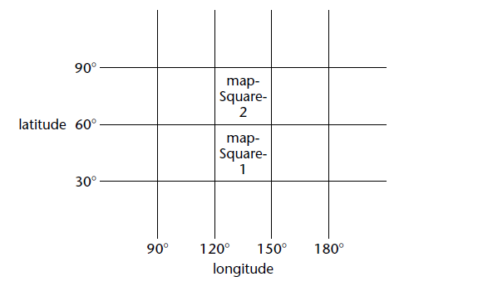
Contnd..
Nested if Statements

Slide 25

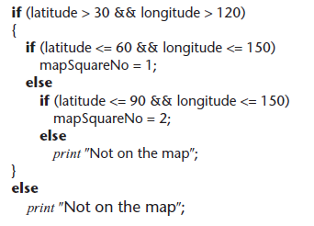
Contnd..
Badly formatted
Well-formatted, badly constructed

Slide 26
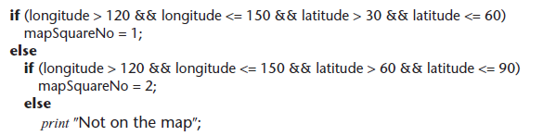
Contnd..
Acceptably nested
If statements nested to a depth of greater than three should be avoided as poor programming practice

Slide 27
Contnd..
Programming Standards
Standards can be both a blessing and a curse
Modules of coincidental cohesion arise from rules like
“Every module will consist of between 35 and 50 executable statements”
No standard can ever be universally applicable.
Standards imposed from above will be ignored.
Standard must be checkable by machine.
The aim of standards is to make maintenance easier
If they make development difficult, then they must be modified
Overly restrictive standards are counterproductive
The quality of software suffers

Slide 28
Contnd..
Code Reuse
Code reuse is the most common form of reuse
However, artifacts from all workflows can be reused
Integration
The approach up to now:
Implementation followed by integration
This is a poor approach
Better:
Combine implementation and integration methodically

Slide 29
STRUCTURED PROGRAMMING
The structured programming was proposed to limit the procedural design of software to a small number of predictable operations
Fundamental Constructs
Sequence implements processing steps that are essential in the specification of any algorithm
Condition provides the facility for selected processing based on some logical occurrence
Repetition allows for looping
Use of the structured constructs reduces program complexity and thereby enhances readability, testability, and maintainability

Slide 30
Contnd..
Structured constructs are logical chunks that allow a reader to recognize procedural elements of a module, rather than reading the design or code line by line
Any program, regardless of application area or technical complexity, can be designed and implemented using only the three structured constructs.

Slide 31
Graphical Design Notation
Flow Chart
A box is used to indicate a processing step.
A diamond represents a logical condition,
An arrows show the flow of control

Slide 32
Contnd..
Drawbacks
Additional complication of all logical tests along the path of escape can cloud software control flow, increase the possibility of error, and have a negative impact on readability and maintainability
Solution
The procedural representation is redesigned so that the "escape branch" is not required at a nested location in the flow of control
The structured constructs are violated in a controlled manner; that is, a constrained branch out of the nested flow is designed.

Slide 33
SOFTWARE TESTING FUNDAMENTALS
Destructive rather than constructive.
The goal is to find errors
Design and implement a testable software.
Testability - How easily a program can be tested.
Characteristics for testable software
Operability
The better it works more efficiently it can be tested
Observability
What you see is what you test
Controllability
Control over the software
Automated and optimized testing
Decomposability
Modules are tested independently
Isolate problems
Simplicity
Functional, Structural & Code simplicity
Stability
The fewer the changes the fewer the disruptions to testing
Understandability
More the information smaller the test

Slide 34
Test Characteristics
A good test has a high probability of finding an error
A good test is not redundant
A good test should be best of breed
A good test should be neither too simple nor too complex

Slide 35
TEST CASE DESIGN
Set of conditions or variables under which a tester will determine whether an application or software system is working correctly.
Any engineered product (and most other things) can be tested in one of two ways:
Knowing the specified function that a product has been designed to perform, tests can be conducted that demonstrate each function is fully operational while at the same time searching for errors in each function; this approach is called black-box testing.
knowing the internal workings of a product, tests can be conducted to ensure that the internal operations are performed according to specifications and all internal components have been adequately exercised. This approach is called, white-box testing.

Slide 36
WHITE-BOX TESTING
White-box testing, sometimes called glass-box testing, is a test case design method that uses the control structure described as part of component level design to derive test cases.
Using white-box testing methods, the software engineer can derive test cases that
Guarantee that all independent paths within a module have been exercised at least once,
Exercise all logical decisions on their true and false sides,
Execute all loops at their boundaries and within their operational bounds,
Exercise internal data structures to ensure their validity

Slide 37
BASIS PATH TESTING
A white-box testing technique
The test case designer derives a logical complexity measure of a procedural design and use this measure as a guide for defining a basis set of execution paths.
Test cases derived to exercise the basis set are guaranteed to execute every statement in the program at least one time during testing

Slide 38
Contnd..
Flow Graph (Program Graph) Notation
Depicts logical control flow
Each structured construct has a corresponding flow graph symbol.
Where each circle represents one or more nonbranching PDL or source code statements

Slide 39
Contnd..
Procedural design – flowchart
Maps the flowchart into a corresponding flow graph
Assumes no compound conditions contained in the decision diamond.

Slide 40
Contnd..
Circle in the flow graph, called a flow graph node, represents one or more procedural statements.
A sequence of process boxes and a decision diamond can map into a single node.
The arrows on the flow graph, called edges or links, represent flow of control and are analogous to flowchart arrows
An edge must terminate at a node, even if the node does not represent any procedural statements.
Areas bounded by edges and nodes are called regions.
When counting regions, we include the area outside the graph as a region

Slide 41
A separate node is created for compound conditions
One or more Boolean operators (logical OR, AND, NAND, NOR) is present in a conditional statement.
Each node that contains a condition is called a predicate node and is characterized by two or more edges emanating from it.

Slide 42
Contnd..
Independent path
Any path through the program that introduces at least one new set of processing statements or a new condition.
An independent path must move along at least one edge that has not been traversed before the path is defined
path 1: 1-11
path 2: 1-2-3-4-5-10-1-11
path 3: 1-2-3-6-8-9-10-1-11
path 4: 1-2-3-6-7-9-10-1-11
1-2-3-4-5-10-1-2-3-6-8-9-10-1-11
is not considered to be an independent path because it is simply a combination of already specified paths and does not traverse any new edges

Slide 43
Contnd..
Paths 1, 2, 3, and 4 constitute a basis set for the flow graph
If tests can be designed to force execution of these paths (a basis set),
Every statement in the program will have been guaranteed to be executed at least one time and
Every condition will have been executed on its true and false sides
Basis set is not unique
A number of different basis sets can be derived for a given procedural design.
The computation of cyclomatic complexity provides the number

Slide 44
Contnd..
The Cyclomatic Complexity is a software metric that provides a quantitative measure of the logical complexity of the program.
Defines the number of independent paths in the basis set of a program and provides with an upper bound for the number of tests that must be conducted to ensure that all statements have been executed at least once.
Cyclomatic complexity has a foundation in graph theory and provides us with an extremely useful software metric.

Slide 45
Contnd..
Complexity is computed in one of three ways:
The number of regions of the flow graph correspond to the cyclomatic complexity.
Cyclomatic complexity, V(G), for a flow graph, G, is defined as
V(G) = E - N + 2
where E is the number of flow graph edges, N is the number of flow graph nodes.
Cyclomatic complexity, V(G), for a flow graph, G, is also defined as
V(G) = P + 1
where P is the number of predicate nodes contained in the flow graph G.

Slide 46
Contnd..
Referring once more to the flow graph, the cyclomatic complexity can be computed using each of the algorithms just noted:
The flow graph has four regions.
V(G) = 11 edges 9 nodes + 2 = 4.
V(G) = 3 predicate nodes + 1 = 4

Slide 47
Deriving Test Cases
Using the design or code as a foundation, draw a corresponding flow graph
Determine the cyclomatic complexity of the resultant flow graph
Determine a basis set of linearly independent paths
Prepare test cases that will force execution of each path in the basis set.

Slide 48
Example

Slide 49
Contnd…
Cyclomatic Complexity
V(G) 6 regions
V(G) 17 edges - 13 nodes + 2 = 6
V(G) 5 predicate nodes + 1 = 6
Predicate Nodes
2, 3, 5, 6, and 10
Independent Paths
Path 1: 1-2-9-10-11-13
Path 2: 1-2-9-10-12-13
Path 3: 1-2-3-9-10-11-13
Path 4: 1-2-3-4-5-8-2-. . .
Path 5: 1-2-3-4-5-6-8-2-. . .
Path 6: 1-2-3-4-5-6-7-8-2-. . .

Slide 50
Contnd
Path 1 test case:
value(k) = valid input, where k < i for 2 ≤ i ≤ 100
value(i) = 999 where 2 ≤ i ≤ 100
Expected results: Correct average based on k values and proper totals.
Note: Path 1 cannot be tested stand-alone but must be tested as part of path 4, 5, and 6 tests.
Path 2 test case:
value(1) = 999
Expected results: Average = 999; other totals at initial values.
Path 3 test case:
Attempt to process 101 or more values.
First 100 values should be valid.
Expected results: Same as test case 1.

Slide 51
Contnd..
Path 4 test case:
value(i) = valid input where i < 100
value(k) < minimum where k < i
Expected results: Correct average based on k values and proper totals.
Path 5 test case:
value(i) = valid input where i < 100
value(k) > maximum where k <= i
Expected results: Correct average based on n values and proper totals.
Path 6 test case:
value(i) = valid input where i < 100
Expected results: Correct average based on n values and proper totals.
Some independent paths cannot be tested in stand-alone fashion

Slide 52
Graph Matrices
Tabular representation of a flow graph
Useful for developing a software tool that assists in basis path testing.
A square matrix whose size (i.e., number of rows and columns) is equal to the number of nodes on the flow graph.
Each row and column corresponds to an identified node, and matrix entries correspond to connections (an edge) between nodes.
Each node on the flow graph is identified by numbers,
Each edge is identified by letters
A letter entry is made in the matrix to correspond to a connection between two nodes

Slide 53
Example

Slide 54
By adding a link weight to each matrix entry, the graph matrix can become a powerful tool for evaluating program control structure during testing.
The link weight is 1 (a connection exists) or 0 (a connection does not exist).
Assigned properties of link weights
The probability that a link (edge) will be executed.
The processing time expended during traversal of a link.
The memory required during traversal of a link.
The resources required during traversal of a link.

Slide 55
Each letter in the graph matrix has been replaced with a 1, indicating that a connection exists (zeros have been excluded for clarity).
Represented in this form, the graph matrix is called a connection matrix.

Slide 56
Contnd..
Each row with two or more entries represents a predicate node.
Performing the arithmetic shown to the right of the connection matrix provides us with still another method for determining cyclomatic complexity
Using these techniques, the analysis required to design test cases can be partially or fully automated

Slide 57
Control Structure Testing
Variations on control structure testing
Condition Testing
A test case design method that exercises the logical conditions contained in a program module
A relational expression takes the form
E1 <relational-operator> E2
where E1 and E2 are arithmetic expressions
<relational-operator> is one of the following: <, ≤, =, ≠ (nonequality), >, or ≥.
A compound condition is composed of two or more simple conditions, Boolean operators, and parentheses.
We assume that Boolean operators allowed in a compound condition include OR (|), AND (&) and NOT (¬).
A condition without relational expressions is referred to as a Boolean expression.

Slide 58
Contnd..
The possible types of elements in a condition include
a Boolean operator,
a Boolean variable,
a pair of Boolean parentheses (surrounding a simple or compound condition),
a relational operator,
an arithmetic expression
If a condition is incorrect, then at least one component of the condition is incorrect.
Types of errors in a condition include the following:
Boolean operator error (incorrect/missing/extra Boolean operators).
Boolean variable error.
Boolean parenthesis error.
Relational operator error.
Arithmetic expression error.

Slide 59
Contnd..
Advantages.
Focuses on testing each condition in the program
First, measurement of test coverage of a condition is simple.
Second, the test coverage of conditions in a program provides guidance for the generation of additional tests for the program.
Focuses on testing each condition in the program to ensure that it does not contain errors.

Slide 60
Data Flow Testing
The data flow testing method selects test paths of a program
Variables in the program
According to the locations of definitions and use
E.g. assume that each statement in a program is assigned a unique statement number and that each function does not modify its parameters or global variables. For a statement with S as its statement number,
DEF(S) = {X | statement S contains a definition of X}
USE(S) = {X | statement S contains a use of X}
If statement S is an if or loop statement, its DEF set is empty and its USE set is based on the condition of statement S.
The definition of variable X at statement S is said to be live at statement S' if there exists a path from statement S to statement S' that contains no other definition of X.
A definition-use (DU) chain of variable X is of the form [X, S, S'], where S and S' are statement numbers, X is in DEF(S) and USE(S'), and the definition of X in statement S is live at statement S'.

Slide 61
Contnd..
One simple data flow testing strategy is to require that every DU chain be covered at least once (DU testing strategy).
It has been shown that DU testing does not guarantee the coverage of all branches of a program.
A branch is not guaranteed to be covered by DU testing only in rare situations such as
if-then-else constructs in which the then part has no definition of any variable and the else part does not exist.
The else branch of the if statement is not necessarily covered by DU testing.
Data flow testing strategies are useful for selecting test paths of a program containing nested if and loop statements.

Slide 62
Loop Testing
Loop testing is a white-box testing technique that focuses exclusively on the validity of loop constructs.
Different classes of loops;
Simple loops
The following set of tests can be applied to simple loops, where n is the maximum number of allowable passes through the loop.
Skip the loop entirely.
Only one pass through the loop.
Two passes through the loop.
m passes through the loop where m < n.
n - 1, n, n + 1 passes through the loop.

Slide 63
Nested loops.
If we were to extend the test approach for simple loops to nested loops, the number of possible tests would grow geometrically as the level of nesting increases.
This would result in an impractical number of tests.
An approach that will help to reduce the number of tests:
Start at the innermost loop. Set all other loops to minimum values.
Conduct simple loop tests for the innermost loop while holding the outer loops at their minimum iteration parameter (e.g., loop counter) values. Add other tests for out-of-range or excluded values.
Work outward, conducting tests for the next loop, but keeping all other outer loops at minimum values and other nested loops to "typical" values.
Continue until all loops have been tested.

Slide 64
Concatenated loops. Concatenated loops can be tested using the approach defined for simple loops, if each of the loops is independent of the other.
However, if two loops are concatenated and the loop counter for loop1 is used as the initial value for loop 2, then the loops are not independent.
When the loops are not independent, the approach applied to nested loops is recommended.
Unstructured loops. Whenever possible, this class of loops should be redesigned to reflect the use of the structured programming constructs

Slide 65
BLACK-BOX TESTING
Black-box testing, also called behavioural testing, focuses on the functional requirements of the software.
Black-box testing enables the software engineer to derive sets of input conditions that will fully exercise all functional requirements for a program.
Black-box testing is not an alternative to white-box techniques. Rather, it is a complementary approach that is likely to uncover a different class of errors than white-box methods.

Slide 66
Contnd..
Black-box testing attempts to find errors in the following categories:
Incorrect or missing functions,
Interface errors,
Errors in data structures or external data base access,
Behaviour or performance errors, and
Initialization and termination errors.
Black-box testing tends to be applied during later stages of testing.
Because black-box testing purposely disregards control structure, attention is focused on the information domain.

Slide 67
Contnd..
By applying black-box techniques, we derive a set of test cases that satisfy the following criteria
Test cases that reduce, by a count that is greater than one, the number of additional test cases that must be designed to achieve reasonable testing.
Test cases that tell us something about the presence or absence of classes of errors, rather than an error associated only with the specific test at hand.

Slide 68
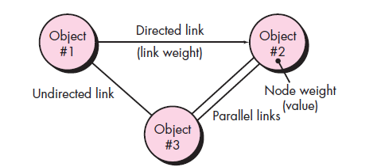
Graph-Based Testing Methods
Software testing begins by
Creating a graph of important objects and their relationships and
Then devising a series of tests that will cover the graph so that each object and relationship is exercised and errors are uncovered.
A graph
A collection of nodes that represent objects;
links that represent the relationships between objects;
node weights that describe the properties of a node (e.g., a specific data value or state behaviour); and
link weights that describe some characteristic of a link.

Slide 69
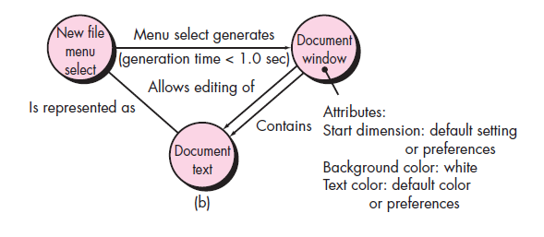
Nodes are represented as circles connected by links that take a number of different forms.
A directed link (represented by an arrow) indicates that a relationship moves in only one direction.
A bidirectional link, also called a symmetric link, implies that the relationship applies in both directions.
Parallel links are used when a number of different relationships are established between graph nodes.
As a simple example, consider a portion of a graph for a word-processing application figure where
Object #1 = new file menu select
Object #2 = document window
Object #3 = document text

Slide 70
Contnd..
A menu select on new file generates a document window.
The node weight of document window provides a list of the window attributes that are to be expected when the window is generated.
The link weight indicates that the window must be generated in less than 1.0 second.
An undirected link establishes a symmetric relationship between the new file menu select and document text,
Parallel links indicate relationships between document window and document text.
The software engineer then derives test cases by traversing the graph and covering each of the relationships shown.
These test cases are designed in an attempt to find errors in any of the relationships.

Slide 71
Behavioural testing methods that can make use of graphs:
Transaction flow modelling
The nodes represent steps in some transaction (e.g., the steps required to make an airline reservation using an on-line service),
The links represent the logical connection between steps (e.g.,flightInformationIinput is followed by validation/availabilityProcessing).
The data flow diagram can be used to assist in creating graphs of this type.
Finite state modelling
The nodes represent different user observable states of the software (e.g., each of the “screens” that appear as an order entry clerk takes a phone order),
The links represent the transitions that occur to move from state to state (e.g., orderInformation is verified during inventoryAvailabilityLook-up and is followed by customerBillingInformation input).
The state transition diagram can be used to assist in creating graphs of this type.

Slide 72
Contnd..
Data flow modeling
The nodes are data objects and the links are the transformations that occur to translate one data object into another.
For example, the node FICA.tax.withheld (FTW) is computed from gross.wages (GW) using the relationship, FTW = 0.62 GW.
Timing modeling.
The nodes are program objects and the links are the sequential connections between those objects.
Link weights are used to specify the required execution times as the program executes.

Slide 73
Contnd..
Graph-based testing begins with the definition of all nodes and node weights.
To provide an indication of the start and stop points for the graph, it is useful to define entry and exit nodes
Links and link weights should be established.
Loop testing can also be applied.
The transitivity of sequential relationships is studied to determine how the impact of relationships propagates across objects defined in a graph.
If a link is indeed bidirectional (symmetric), it is important to test this feature.
Reflexive relationships should also be tested.
Achieve node coverage & link coverage.

Slide 74
Equivalence Partitioning
Equivalence partitioning is a black-box testing method that divides the input domain of a program into classes of data from which test cases can be derived.
Define a test case that uncovers classes of errors, thereby reducing the total number of test cases that must be developed.
An equivalence class represents a set of valid or invalid states for input conditions.
Equivalence classes may be defined according to the following guidelines:
If an input condition specifies a range, one valid and two invalid equivalence classes are defined.
If an input condition requires a specific value, one valid and two invalid equivalence classes are defined.
If an input condition specifies a member of a set, one valid and one invalid equivalence class are defined.
If an input condition is Boolean, one valid and one invalid class are defined.

Slide 75
Boundary Value Analysis
A greater number of errors tends to occur at the boundaries of the input domain rather than in the "centre.“
Boundary value analysis is a test case design technique that complements equivalence partitioning. Rather than selecting any element of an equivalence class, BVA leads to the selection of test cases at the "edges" of the class.
Rather than focusing solely on input conditions, BVA derives test cases from the output domain as well.

Slide 76
Guidelines for BVA are similar in many respects to those provided for equivalence partitioning:
If an input condition specifies a range bounded by values a and b, test cases should be designed with values a and b and just above and just below a and b.
If an input condition specifies a number of values, test cases should be developed that exercise the minimum and maximum numbers. Values just above and below minimum and maximum are also tested.
Apply guidelines 1 and 2 to output conditions. For example, assume that a temperature vs. pressure table is required as output from an engineering analysis program. Test cases should be designed to create an output report that produces the maximum (and minimum) allowable number of table entries.
If internal program data structures have prescribed boundaries (e.g., an array has a defined limit of 100 entries), be certain to design a test case to exercise the data structure at its boundary.

Slide 77
Comparison Testing
Back-to-back testing
Each version can be tested with the same test data to ensure that all provide identical output.
All versions are executed in parallel with real-time comparison of results to ensure consistency.

Slide 78
Orthogonal Array Testing
Orthogonal array testing can be applied to problems in which the input domain is relatively small but too large to accommodate exhaustive testing.
Useful in finding errors associated with region faults—an error category associated with faulty logic within a software component.

Slide 79
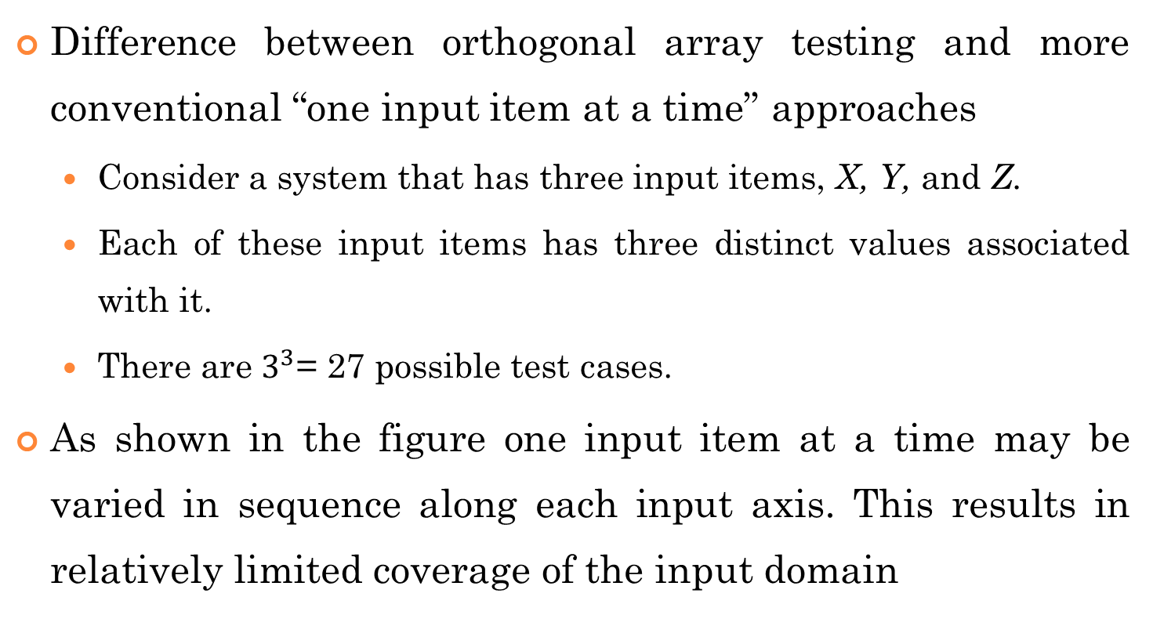
Contnd..
Difference between orthogonal array testing and more conventional “one input item at a time” approaches
Consider a system that has three input items, X, Y, and Z.
Each of these input items has three distinct values associated with it.
There are $3^{3}$= 27 possible test cases.
As shown in the figure one input item at a time may be varied in sequence along each input axis. This results in relatively limited coverage of the input domain

Slide 80
When orthogonal array testing occurs, an L9 orthogonal array of test cases is created.
Has a “balancing property.”
Test cases (represented by black dots in the figure) are “dispersed uniformly throughout the test domain,” as illustrated in the figure
Test coverage across the input domain is more complete.

Slide 81
Levels of Testing
Generic Characteristics of Test Strategies
Testing begins at the component level and works "outward" toward the integration of the entire computer-based system.
Different testing techniques are appropriate at different points in time.
Testing is conducted by the developer of the software and (for large projects) an independent test group.
Testing and debugging are different activities, but debugging must be accommodated in any testing strategy.

Slide 82
Verification and Validation (V&V)
Verification refers to the set of activities that ensure that software correctly implements a specific function.
"Are we building the product right?"
Validation refers to a different set of activities that ensure that the software that has been built is traceable to customer requirements.
"Are we building the right product?"

Slide 83
Levels of Testing

Slide 84
Unit Testing
A verification effort on the smallest unit of software design (the software component or module).
Using the component-level design description as a guide, important control paths are tested to uncover errors within the boundary of the module.
The relative complexity of tests and uncovered errors is limited by the constrained scope established for unit testing.
The unit test is white-box oriented.
The step can be conducted in parallel for multiple components.

Slide 85
Unit Test Considerations

Slide 86
Unit Test Procedures
Considered as an assistant to the coding step.
After source level code has been developed, reviewed, and verified for correspondence to component level design, unit test case design begins.
Each test case should be coupled with a set of expected results.

Slide 87
Contnd..
Unit testing is simplified when a component with high cohesion is designed.
When only one function is addressed by a component,
The number of test cases is reduced
Errors can be more easily predicted and uncovered.

Slide 88
Integration Testing
A systematic technique for constructing the program structure while at the same time conducting tests to uncover errors associated with interfacing.
The objective is to take unit tested components and build a program structure that has been dictated by design.
Problems of “big bang" approach
Solution - incremental integration

Slide 89
Incremental integration strategies
Top-down Integration
Modules are integrated by moving downward through the control hierarchy,
Beginning with the main control module (main program).
Modules subordinate (and ultimately subordinate) to the main control module are incorporated into the structure in either a depth-first or breadth-first manner.
Depth-first integration
M1,M2,M5.M8 (M6)
Breadth-first integration
M1,M2,M3,M4

Slide 90
The integration process is performed in a series of five steps:
The main control module is used as a test driver and stubs are substituted for all components directly subordinate to the main control module.
Depending on the integration approach selected (i.e., depth or breadth first), subordinate stubs are replaced one at a time with actual components.
Tests are conducted as each component is integrated.
On completion of each set of tests, another stub is replaced with the real component.
Regression testing may be conducted to ensure that new errors have not been introduced.

Slide 91
Contnd..
Verifies major control or decision points early in the test process.
If depth-first integration is selected, a complete function of the software may be implemented and demonstrated
Problem
Stubs replace low-level modules at the beginning of top-down testing; therefore, no significant data can flow upward in the program structure.
Solution
Delay many tests until stubs are replaced with actual modules,
Develop stubs that perform limited functions that simulate the actual module,
Integrate the software from the bottom of the hierarchy upward.

Slide 92
Bottom-up Integration
Begins construction and testing with atomic modules
Need for stubs is eliminated.
A bottom-up integration strategy may be implemented with the following steps:
Low-level components are combined into clusters (sometimes called builds) that perform a specific software sub-function.
A driver (a control program for testing) is written to coordinate test case input and output.
The cluster is tested.
Drivers are removed and clusters are combined moving upward in the program structure.

Slide 93
Components are combined to form clusters 1, 2, and 3.
Each of the clusters is tested using a driver.
Components in clusters 1 and 2 are subordinate to Ma.
Drivers D1 and D2 are removed and the clusters are interfaced directly to Ma.
Similarly, driver D3 for cluster 3 is removed prior to integration with module Mb.
Both Ma and Mb will ultimately be integrated with component Mc, and so forth.

Slide 94
Regression Testing
Each time a new module is added as part of integration testing, the software changes.
New data flow paths are established,
New I/O may occur,
New control logic is invoked.
These changes may cause problems with functions that previously worked flawlessly.
Regression testing is the activity that helps to ensure that changes (due to testing or for other reasons) do not introduce unintended behavior or additional errors.
Regression testing may be conducted manually, by re-executing a subset of all test cases
or using automated capture/playback tools

Slide 95
Contnd..
Different classes of test cases of regression test suite :
A representative sample of tests that will exercise all software functions.
Additional tests that focus on software functions that are likely to be affected by the change.
Tests that focus on the software components that have been changed.
Include only those tests that address one or more classes of errors in each of the major program functions

Slide 96
Smoke Testing
Smoke testing is an integration testing approach that is commonly used when “shrink wrapped” software products (time-critical) are being developed
Activities:
Software components that have been translated into code are integrated into a “build.”
A build includes all data files, libraries, reusable modules, and engineered components that are required to implement one or more product functions.
A series of tests is designed to expose errors that will keep the build from properly performing its function.
The intent should be to uncover “show stopper” errors that have the highest likelihood of throwing the software project behind schedule.
The build is integrated with other builds and the entire product (in its current form) is smoke tested daily. The integration approach may be top down or bottom up.

Slide 97
Contnd..
Benefits
Integration risk is minimized
The quality of the end-product is improved
Error diagnosis and correction are simplified
Progress is easier to assess.

Slide 98
Conclusion
sandwich testing
Identify critical modules
Characteristics:
Addresses several software requirements,
Has a high level of control (resides relatively high in the program structure),
Is complex or error prone (cyclomatic complexity may be used as an indicator), or
Has definite performance requirements.
Critical modules should be tested as early as is possible.
In addition, regression tests should focus on critical module function.

Slide 99
Integration Test Documentation
Test Specification
Test plan: overall strategy for integration
Test procedure,
A history of actual test results,
Problems,
Peculiarities

Slide 100
VALIDATION TESTING- Testing Criteria
Software validation is achieved through a series of black-box tests that demonstrate conformity with requirements.
A test plan outlines the classes of tests to be conducted and
A test procedure defines specific test cases that will be used to demonstrate conformity with requirements.
Both the plan and procedure are designed to ensure that
all functional requirements are satisfied,
all behavioural characteristics are achieved,
all performance requirements are attained,
documentation is correct,
other requirements are met (e.g., transportability, compatibility, error recovery, maintainability).

Slide 101
Contnd..
Two possible conditions after validation testing
The function or performance characteristics conform to specification and are accepted or
A deviation from specification is uncovered and a deficiency list is created.
Deviation or error discovered at this stage in a project can rarely be corrected prior to scheduled delivery.
It is often necessary to negotiate with the customer to establish a method for resolving deficiencies.

Slide 102
Contnd..
Configuration Review
The intent of the review is to ensure that
all elements of the software configuration have been properly developed,
are catalogued, and
have the necessary detail to support the support phase of the software life cycle.
Alpha and Beta Testing
When custom software is built for one customer- a series of acceptance tests.
If software is developed as a product to be used by many customers-Alpha & Beta Tests.

Slide 103
The alpha test
Conducted at the developer's site by a customer.
The software is used in a natural setting with the developer "looking over the shoulder" of the user and recording errors and usage problems.
Conducted in a controlled environment.
The beta test
Conducted at one or more customer sites by the end-user of the software.
The developer is generally not present.
The beta test is a "live" application of the software in an environment that cannot be controlled by the developer.
The customer records all problems (real or imagined) that are encountered during beta testing and reports these to the developer at regular intervals.
Software engineers make modifications and then prepare for release of the software product to the entire customer base.

Slide 104
System Testing
Software is incorporated with other system elements (e.g., hardware, people, information)
System testing is actually a series of different tests whose primary purpose is to fully exercise the computer-based system.
Recovery Testing
Recovery testing is a system test that forces the software to fail in a variety of ways and verifies that recovery is properly performed.
If recovery is automatic (performed by the system itself), re-initialization, check-pointing mechanisms, data recovery, and restart are evaluated for correctness.
If recovery requires human intervention, the mean-time-to-repair (MTTR) is evaluated to determine whether it is within acceptable limits.

Slide 105
Contnd..
Security Testing
Security testing attempts to verify that protection mechanisms built into a system will, in fact, protect it from improper penetration.
Penetration spans a broad range of activities:
Hackers who attempt to penetrate systems for sport;
Disgruntled employees who attempt to penetrate for revenge;
Dishonest individuals who attempt to penetrate for illicit personal gain.
The tester plays the role(s) of the individual who desires to penetrate the system.

Slide 106
Contnd..
Anything goes! The tester may attempt to
acquire passwords through external clerical means;
may attack the system with custom software designed to breakdown any defences that have been constructed;
may overwhelm the system, thereby denying service to others;
may purposely cause system errors, hoping to penetrate during recovery;
may browse through insecure data, hoping to find the key to system entry.
The role of the system designer is to make penetration cost more than the value of the information that will be obtained.

Slide 107
Contnd..
Stress Testing
Executes a system in a manner that demands resources in abnormal quantity, frequency, or volume.
Sensitivity testing (a stress testing variant)
Attempts to uncover data combinations within valid input classes that may cause instability or improper processing.

Slide 108
Contnd..
Performance Testing
Designed to test the run-time performance of software within the context of an integrated system.
Performance testing occurs throughout all steps in the testing process.
Performance tests are often coupled with stress testing and usually require both hardware and software instrumentation
External instrumentation can monitor
execution intervals,
log events (e.g., interrupts) as they occur, and
sample machine states on a regular basis

Slide 109
Contnd..
Deployment Testing (configuration testing)
Exercises the software in each environment in which it is to operate.
Examines all installation procedures and specialized installation software (e.g., “installers”) that will be used by customers,
All documentation that will be used to introduce the software to end users.

Slide 110
DEBUGGING
Debugging occurs as a consequence of successful testing.
The process that results in the removal of the error.
Two outcomes:
The cause will be found and corrected, or
The cause will not be found.

Slide 111
Contnd..
Debugging Approaches
Brute force,
Backtracking, and
Cause elimination

